Slide 1

Data 603 – Big Data Platforms
Lecture 2
Distributed File Systems

Slide 2
Lecture 2 Outline
Homework Review
Slack Channel for the class
What is Docker
Installing PySpark in Docker
File System Concepts
Distributed File Systems
Hadoop Distributed File System (HDFS)
Examples of Hadoop clients: Hbase, Accumulo, Cassandra
Hadoop Ecosystem
Project and Paper Topics

Slide 3
Homework Review
Git / pull requests
Python/Jupyter approach
Bash approach

Slide 4
Slack
Slack Channel: data603-sp22-enkeboll
(my user: @enkeboll)

Slide 5
PySpark Local Install
https://vimeo.com/507778388
alternatively, just use Docker:
docker pull jupyter/pyspark-notebook

Slide 6

Filesystem

Slide 7
Filesystem - Definition
“A filesystem is the methods and data structures that an operating system uses to keep track of files on a disk or partition; that is, the way the files are organized on the disk.”
Reference: https://tldp.org/LDP/sag/html/filesystems.html
A subsystem of the operating system that provides protection via access control (security), storage, retrieval and naming of files.
Controls how data is stored and retrieved
The structure and logic rules used to manage the groups of data and their names
Reference: https://en.wikipedia.org/wiki/File_system

Slide 8
Filesystem - Architecture
Logical File System
Abstraction layer, provides interaction with user applications via APIs (READ, OPEN, CLOSE)
Virtual File System
Allows client applications to access different types of concrete file systems in a uniform way. E.g. access to local and network storage devices without the client application needing to have different behavior.
Physical File System
Operations of the storage device including reading, writing, buffering, memory management via device drivers

Slide 9
Filesystem
Application
Logical Filesystem
Operating System (OS) Kernel
Virtual Filesystem
Ext3
NTFS
NFS
Physical File System

Slide 10
Filesystem - Concepts
Space Management
Organizing files and directories
Keeping physical location within the media where the file objects are located
File names
Human readable name
Identify storage location of the files
Directory Names
Logical collection of files
Flat or hierarchical structure
Metadata
Length of the data, number of blocks/byte count, time created/modified, user id, group id, access permissions (r/w/x), attributes, etc.

Slide 11
Distributed Filesystems

Slide 12
Distributed Filesystems
Filesystems that manage the storage across a network
Do not share block level access to the same storage but use a network protocol.
Allows files to be accessed using the same interfaces as local files
Mounting/unmounting, listing directories, read/write at byte boundaries, system's native permission model
References:
https://en.wikipedia.org/wiki/Clustered_file_system#Distributed_file_systems
https://en.wikipedia.org/wiki/Google_File_System

Slide 13
Distributed Filesystems
Access Transparency: Clients can use the distributed filesystems just like they would use the local filesystems
Concurrency: A modification by one process is coherently presented to other processes reading the file.
Scalability: File system should be able serve varying degree of loads incurred (small to large traffic)
Replication: Files are replicated across different nodes for the scalability
Fault Tolerant: Ability to self-heal during hardware failures
Reference:
https://en.wikipedia.org/wiki/Clustered_file_system#Distributed_file_systems

Slide 14

Hadoop Distributed File System

Slide 15
Hadoop Distributed File System
Source: https://dzone.com/articles/an-introduction-to-hdfs

Slide 16
Hadoop Distributed File System
Hadoop Distributed File System (HDFS) is designed to run on commodity hardware.
Runs on low-cost hardware
Provides Fault Tolerance
Quick automated detection and recovery from hardware/software failures.
High throughput access to applications with need for large data sets.
Tuned to support large files (gigabytes to terabytes in size).
High aggregate data bandwidth and scale to hundreds of nodes in a single cluster, supporting millions of files in a single instance.
The design emphasis is on high throughput of data access.
Not a good choice for low latency data access

Slide 17
HDFS – Design Choices
Simple Coherency Model
Write-once-read-many access model for files
A file once created written, and closed need not be changed.
Simplifies data coherency issues
Enables high throughput data access
Good use case for MapReduce (topic for lecture 3) applications
Moving Computation, not the data
Having the data closer to the compute resources to boost the computational efficiency. Read requests are satisfied from a replica (covered later) that is closest to the reader.
Minimizing the network traffic, and increasing the throughput
Cross Platform Portability
Increasing the adaption of HDFS

Slide 18
HDFS – Implementation
HDFS is implemented using Java language - cross platform portability
A typical deployment has a dedicated machine running the namenode.
Simplifies the architecture
The namenode is the arbitrator and repository for all HDFS metadata.
User data never flows through the namenode
Other instances each run a datanode
It is possible to run multiple datanodes on one machine, but it is not practical.

Slide 19
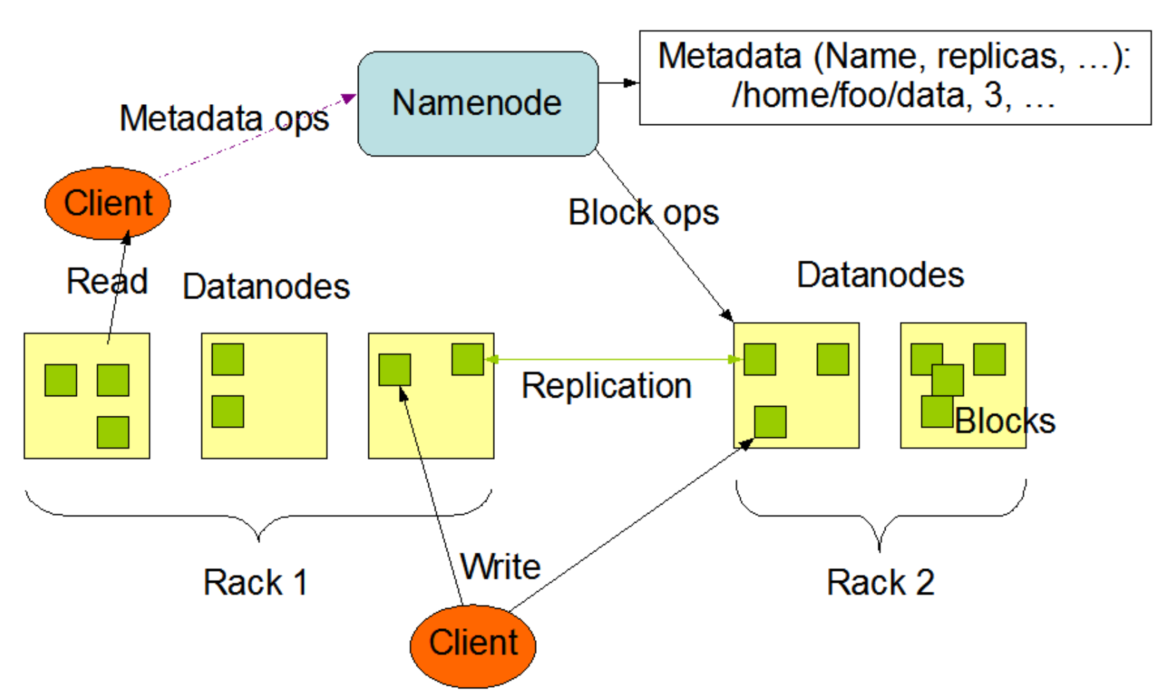
HDFS – Architecture
Hadoop employs a leader/follower architecture

Slide 20
HDFS – Architecture
HDFS cluster consists of a single namenode:
Leader server managing the file system namespace and regulates access to the files by clients.
Executes file system namespace operations (open, close, rename) on files and directories
Determines the mapping of blocks to datanodes
Manages the filesystem tree and the metadata for all the files and directories in the tree.
The filesystem is not functional without the namenode.

Slide 21
HDFS – Architecture
Datanodes
Workers of the filesystem.
Usually one per node in the cluster.
Manages storage attached to the nodes they run on.
A file is split into one or more blocks and they are stored in a set of datanodes
Responsible for serving read and write requests from the file system’s clients.
Perform block creation, deletion, and replication upon instruction from the namenode.

Slide 22
HDFS – Namespace
HDFS supports a traditional hierarchical file organization
Tree like directories can be created
Other files and directories can be stored in a directory
HDFS allows the administrator to set quotas for the number of names used (number of file and directory names in the tree rooted at that directory) and the amount of space (a hard limit on the number of bytes used by files in the tree rooted at that directory) used for individual directories.

Slide 23
HDFS – Permissions
HDFS implements (most of) POSIX model for the file and directory access.
Each file and directory is assigned an owner and a group
Separate permission for the owner, group users and other users
E.g. 755, rwxr-xr-x
Note: HDFS files cannot be executed, so ‘execute’ permissions are ignored.
Reference:
https://hadoop.apache.org/docs/current/hadoop-project-dist/hadoop-hdfs/HdfsPermissionsGuide.html

Slide 24
HDFS – Data Replication
Files are stored as sequences of blocks.
All blocks in a file except the last block are the same size (128 MB by default).
The blocks of a file are replicated for fault tolerance.
The block size and replication factor are configurable per file.
# of replicas can be specified.
The replication factor can be specified at file creation time and can be changed later.
Files in HDFS are write-once and have one writer at any time
All decisions regarding the replication of blocks are made by the namenode.
Heartbeats and Blockreports (a list of all blocks on a datanode) are received from each of the datanodes in the cluster.

Slide 25
HDFS – Data Replication (cont.)
At startup time, each datanode determines the rack ID belongs to and sends its rack ID to the namenode upon registration. Rack IDs are determined using pluggable modules providing rack ID detection APIs.
HDFS placement policy for the replication factor three
One replica on one node in the local rack
Another on a different node in the local rack
Last on a different node in a different rack
Goal: reduce the latency caused by network bandwidth between machines in different rack, at the same time provide the high availability (survive node and rack failures)

Slide 26
HDFS – Metadata
HDFS namespace is stored by the namenode.
A transaction log called the EditLog is used to persist the records of each changes to the file system metadata.
EditLog is stored within the namenode’s local host OS file system.
The entire file system namespace, including the mapping of blocks to files and file system properties, is stored in a file called the FsImage.
The namenode keeps an image of the entire file system namespace and file Blockmap in memory.
Since the namenode holds filesystem metadata in memory, the number of files in a filesystem is limited by the amount of memory on the namenode; not good for a lot of small files.
HDFS federation (since 2.x release) allows adding more namenodes, each to manage a portion of the filesystem namespace

Slide 27
HDFS – Data Storage
HDFS data is stored in each datanode’s local file system.
The datanode has no knowledge about HDFS files.
Each block of HDFS data is stored in a separate file in its local file system.
A heuristic is used to determine the optimal number of files per directories and their subdirectories
During the startup of a datanode, it scans through its local file system and generates a list of all HDFS data blocks corresponding to each of the local files and sends this report (Blockreport) to the namenode

Slide 28
HDFS Client File Read
HDFS Client
1. Get block locations
Namenode
2. Address of the datanode
with copy of the block
3. Read
3. Read
Datanode
Datanode
Datanode

Slide 29
HDFS Client File Write
HDFS Client
1. Create a new file
Namenode
4. Commit
2. Write
3. Ack
Datanode
Write
Datanode
Write
Datanode
Ack
Ack
Replication pipeline

Slide 30
HDFS Commands
https://images.linoxide.com/hadoop-hdfs-commands-cheatsheet.pdf

Slide 31
Hadoop Demo
https://medium.com/analytics-vidhya/hadoop-single-node-cluster-on-docker-e88c3d09a256

Slide 32
Discussion
HDFS is great, but it is complex to maintain.
Are there other alternatives?

Slide 33
More reading
https://hadoop.apache.org/docs/current/hadoop-project-dist/hadoop-hdfs/HdfsDesign.html
Ceph as a scalable alternative to the Hadoop Distributed File System: https://www.usenix.org/system/files/login/articles/73508-maltzahn.pdf
https://databricks.com/blog/2017/05/31/top-5-reasons-for-choosing-s3-over-hdfs.html
Hadoop Ecosystem Table: http://hadoopecosystemtable.github.io/

Slide 34
Pop Quiz
Q1: HDFS consists of a single _____________________

Slide 35
Pop Quiz
Q2: One of the attributes of distributed file system is an ability to self-heal during hardware failures.
What is it called? F____________ T______________

Slide 36
Pop Quiz
Q3: True or False
Every block of data in HDFS flows through the name node.

Slide 37
Concepts
Structured Data
Data with structures: shapes, columns with size and types, rows
Semi-Structured Data
“Semi-structured data is a form of structured data that does not obey the tabular structure of data models associated with relational databases or other forms of data tables, but nonetheless contains tags or other markers to separate semantic elements and enforce hierarchies of records and fields within the data. Therefore, it is also known as self-describing structure”
Key/Value Store
“A key-value database is a type of nonrelational database that uses a simple key-value method to store data. A key-value database stores data as a collection of key-value pairs in which a key serves as a unique identifier. Both keys and values can be anything, ranging from simple objects to complex compound objects. Key-value databases are highly partitionable and allow horizontal scaling at scales that other types of databases cannot achieve”

Slide 38
Concepts
Column Oriented
“While a relational database is optimized for storing rows of data, typically for transactional applications, a columnar database is optimized for fast retrieval of columns of data, typically in analytical applications. Column-oriented storage for database tables is an important factor in analytic query performance because it drastically reduces the overall disk I/O requirements and reduces the amount of data you need to load from disk. Like other NoSQL databases, column-oriented databases are designed to scale “out” using distributed clusters of low-cost hardware to increase throughput, making them ideal for data warehousing and Big Data processing.”
Also read, https://www.geeksforgeeks.org/difference-between-row-oriented-and-column-oriented-data-stores-in-dbms/, https://www.stitchdata.com/columnardatabase/
Random Access
“Ability to access an arbitrary element of a sequence in equal time or any datum from a population of addressable elements roughly as easily and efficiently as any other, no matter how many elements may be in the set. In computer science it is typically contrasted to sequential access which requires data to be retrieved in the order it was stored.”
Sparse
Homework: Do a research on what it means to have sparse data/datastore/database.

Slide 39
HBase
Distributed key/value store, column-oriented database built on top of HDFS.
It promises strong consistency.
Used for real-time read/write and random access to large datasets.
It is able to host large tables on clusters made from commodity hardware
A sparse, distributed, persistent, multidimensional sorted map, indexed by row key, column key, and timestamp
Built to scale linearly by adding more nodes.
Not relational – no support for SQL
Stores structured and semi-structured data naturally
Allows for dynamic and flexible data model
Modeled after Google’s Bigtable

Slide 40
Apache Accumulo
Distributed key/value store.
Keys are sorted at all times.
Created by NSA
Based on Google’s BigTable design
Built on top of Apache Hadoop, Zookeeper, and Thrift.
Accumulo depends on Apache Hadoop for storage and Apache ZooKeeper for configuration.
Thrift proxy allows Accumulo API to non-JVM-based languages.

Slide 41
Apache Cassandra
Highly available, distributed, partitioned row store NoSQL database.
Built to deal with inevitable node failures following AWS Dynamo DB’s design principles.
Replication Factors (RF) and required consistency level provides Cassandra clusters high availability even during nodes failures.
Distributed database – A Cassandra cluster is a collection of nodes working together to serve the same dataset
Nodes can be grouped into logical data centers providing data locality an application.
Adding more nodes also add more disk footprint and the operational throughput.
Partitioned Row Store – Rows of data are stored in tables based on the hashed value of the partition key (token). Each node in the cluster is assigned multiple token ranges.
The Replication Factor decides how many copies of each row will be stored in each data center
Decentralized – every node in the cluster is identical. No single point of failure.

Slide 42
Hadoop Ecosystem
https://hadoopecosystemtable.github.io/

Slide 43
Paper Topic Examples
Compare three popular NoSQL distributed databases. Do a thorough analysis of each database and do a comparison between them.
Good use case?
Strengths?
Weakness?
Data Modeling
What is unique about the particular DB?
Operations & maintenance?
Scalability, high availability, recovery during failure, etc.
The effect of [popular compression algorithm] on Hadoop data lakes
Description of algorithm & competing algorithms
Storage before/after compression
Query performance before/after compression
Non-performance downsides to compression

Slide 44
Project Topic Examples
Data sources:
Kaggle Competitions
Google Dataset Search
OpenData (Baltimore, DC, NYC, etc)
Self-acquired (Reddit, Yelp, Wikipedia)
Project scopes:
MUST INVOLVE SPARK!
Should involve one other technical

Slide 45
Assignment
Read the following articles:
https://www.digitalocean.com/community/tutorials/a-comparison-of-nosql-database-management-systems-and-models
https://databricks.com/glossary/data-lake
Write a summary, no longer than ~250 words, of the technologies and practices described in the two articles
The summary should be written in Markdown
Include a formatted title and at least two section headers
Embed at least one image
Cite the two articles at the end, using hyperlinks (nothing fancy needed, just a bullet or similar with the link)

Slide 46
Assignment Submission
Same as last week
Add your file in a new branch to your github repository as homework/hw02.md
Open a pull request from this branch, tag me as the reviewer
Submit the pull request URL (eg github.com/enkeboll/data603/pull/2) on Blackboard Assignments

Slide 47
Next Week
MapReduce Design Patterns
Introduction to Cloud Computing

